Slide 1
CSE322
Regular Expressions and their Identities
Lecture #6

Slide 2
Regular Expressions
We give a formal recursive definition of regular expressions over ∑ as follows:
1. Any terminal symbol (i.e. an element of ∑), Λ and ∅ are regular
expressions. When we view a in ∑ as a regular expression, we denote it by a.
2. The union of two regular expressions R1and R2 , written as R 1 + R2, is also a regular expression.
3. The concatenation of two regular expressions R1and R2, written as
R1 R2, is also a regular expression.
4. The iteration (or closure) of a regular expression R written as R*, is
also a regular expression.
5.If R is a regular expression, then (R) is also a regular expression.
6. The regular expressions over∑ are precisely those obtained
recursively by the application of the rules 1-5 once or several times

Slide 3
Definitions
Any set represented by a regular expression is called a regular set.
If for example, a, b ε ∑. Then
(i) a denotes the set {a},
(ii) a + b denotes {a, b},
(iii) ab denotes {ab},
(iv) a* denotes the set {lambda, a, aa. aaa, ... } and
(v) (a + b)* denotes {a, b}*. The set represented by R is denoted by L(R),
Notes:
Definitions

Slide 4
Questions
Describe the following sets by regular expressions:
{101}
{abba}
{01,10}
{Λ ,ab}
{abb,a, b, bba}
{Λ , 0, 00, 000.... }
{1, 11, 111 ... }

Slide 5
Solution
(a) Now. {1}. {O} are represented by 1 and O. respectively. 101 is obtained
by concatenating 1,0 and 1 So. {10 I} is represented by 101.
(b) abba represents {abba}.
(c) As {01, 10} is the union of {01} and {10}, we have {01, 10}
represented by 01 + 10
(d) The set {Λ , ab} is represented by Λ + ab
(e) The set {abb, a, b, bba} is represented by abb + a + b + bba.
f) As {Λ , 0, 00, 000, ... } is simply {O}*. it is represented by 0*
(g) Any element in {1, 11, 111, ... } can be obtained by concatenating
1 and any element of {1}*. Hence 1(1)* represents {1, 11, 111, ... }

Slide 6
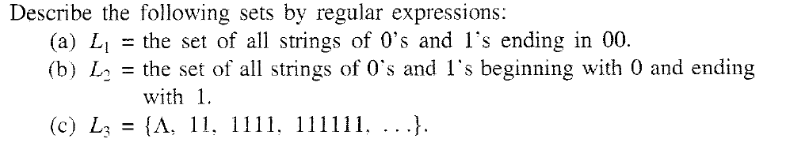
Problem

Slide 7
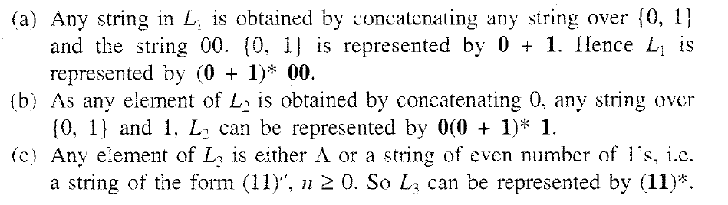
Solution

Slide 8
Solution
(a) Now. {1}. {O} are represented by 1 and O. respectively. 101 is obtained
by concatenating 1,0 and 1 So. {10 I} is represented by 101.
(b) abba represents {abba}.
(c) As {01, 10} is the union of {01} and {10}, we have {01, 10}
represented by 01 + 10
(d) The set {Λ , ab} is represented by Λ + ab
(e) The set {abb, a, b, bba} is represented by abb + a + b + bba.
f) As {Λ , 0, 00, 000, ... } is simply {O}*. it is represented by 0*
(g) Any element in {1, 11, 111, ... } can be obtained by concatenating
1 and any element of {1}*. Hence 1(1)* represents {1, 11, 111, ... }

Slide 9
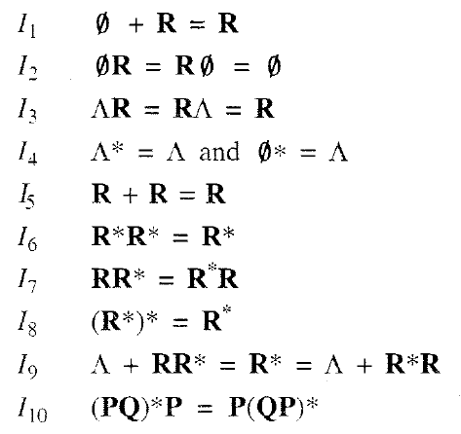

IDENTITIES FOR REGULAR EXPRESSIONS
Notes:
IDENTITIES FOR REGULAR EXPRESSIONS

Slide 10
THEORM
Theorem :
(Arden' s theorem) Let P and Q be two regular expressions over ∑. If P does not contain Λ, then the following equation in R, namely
R = Q + RP
has a unique solution (i.e. one and only one solution) given by R = QP*.

Slide 11
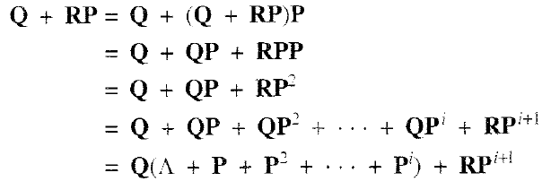
THEORM
Proof
Q + (QP*)P = Q(Λ+ P*P) = QP* by I9

Slide 12
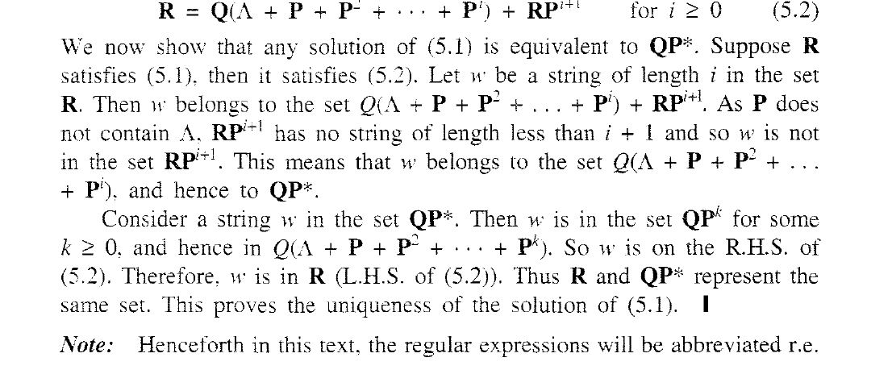
Important justification

Slide 13
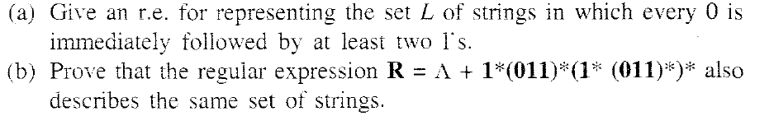
PROBLEM

Slide 14
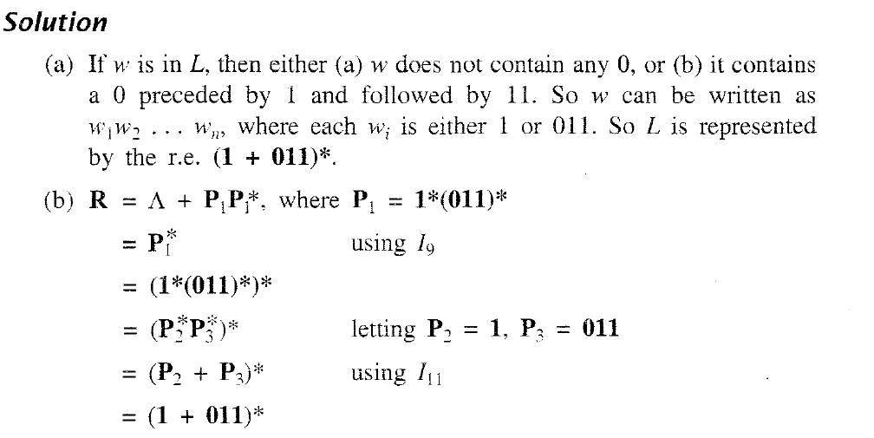
SOLUTION

Slide 15
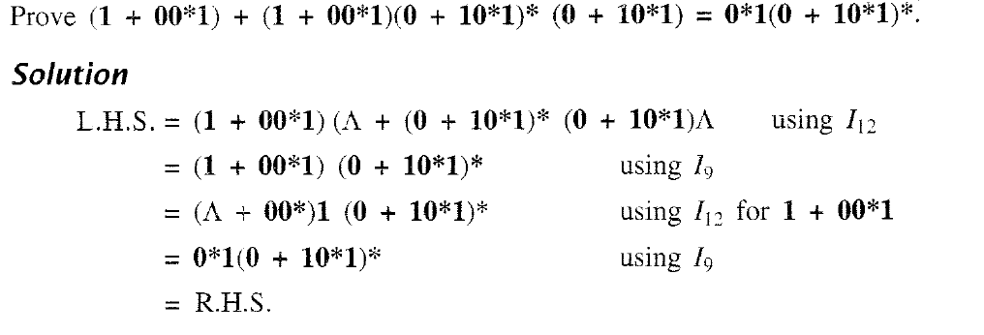
PROBLEM & SOLUTION

Slide 16

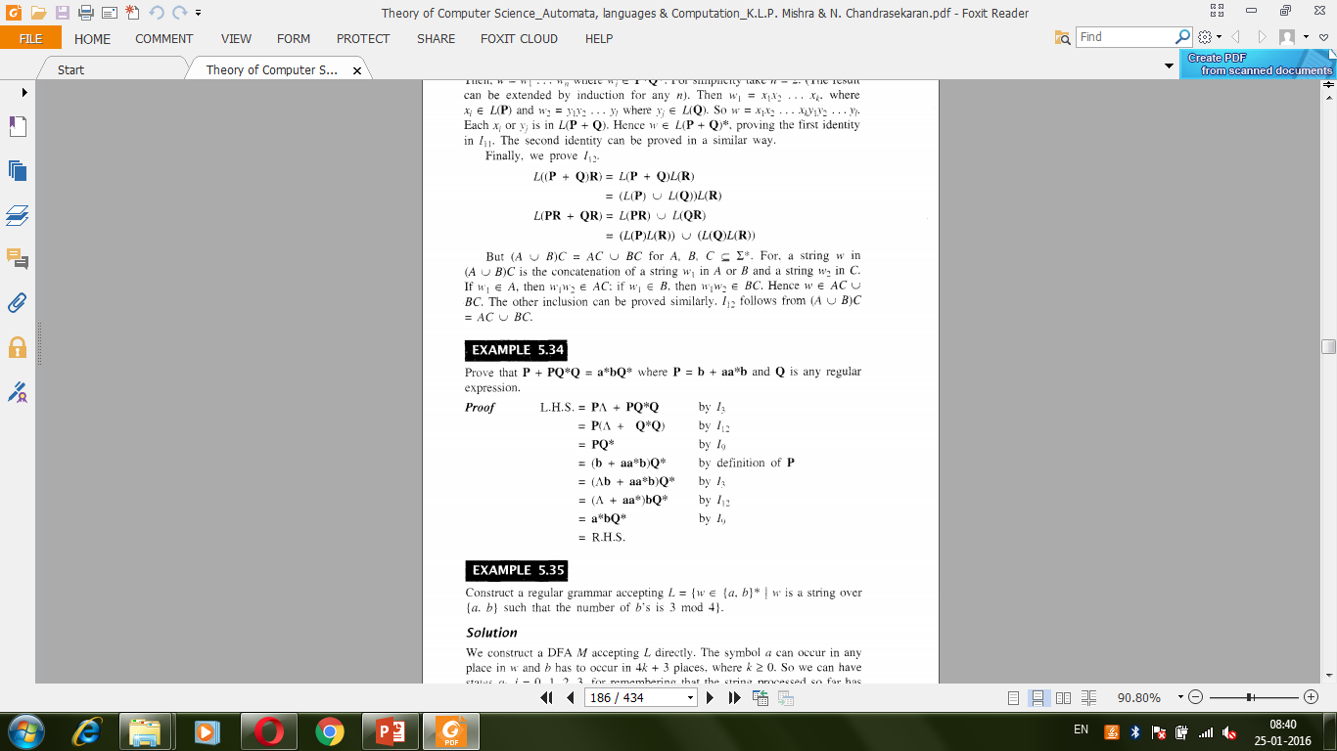

Slide 18
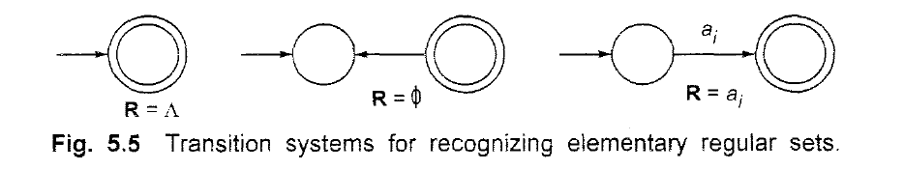
Difference between Null and Ø

Slide 19
TRANSITION SYSTEM CONTAINING Λ -MOVES
Suppose we want to replace a Λ -move from vertex V1 to vertex V2' Then
we proceed as follows:
Step 1- Find all the edges starting from V2.
Step 2- Duplicate all these edges starting from V1' without changing the edge
labels.
Step 3- If V1 is an initial state, make V2 also as initial state.
Step 4- If V2 is a final state. make V1 also as the final state.

Slide 20
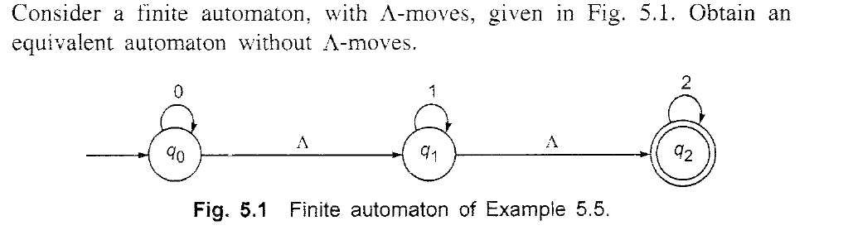
EXAMPLE

Slide 21
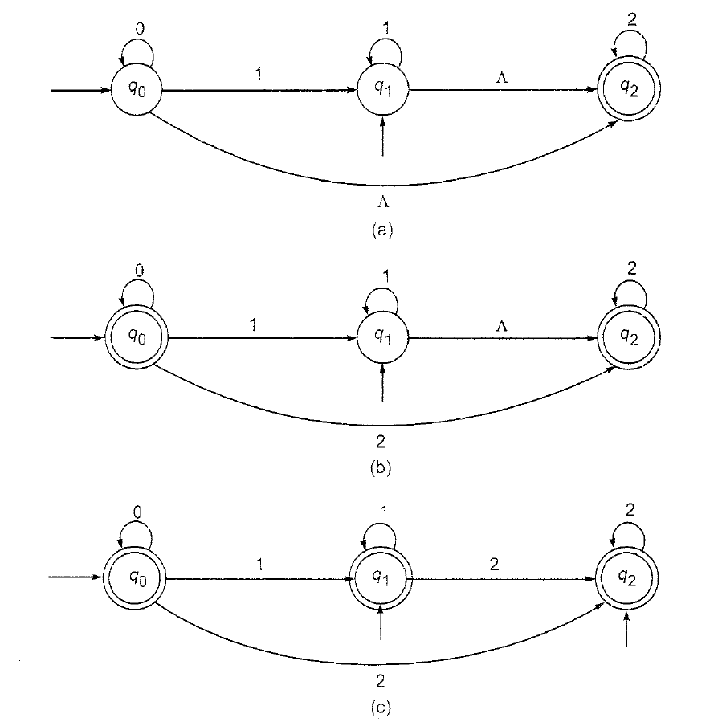
EXAMPLE

Slide 22
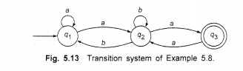
Construct RE from given FA

Slide 23
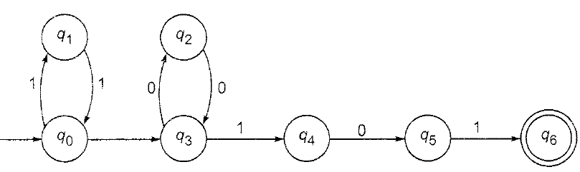
Convert this automata with null moves to automata without it

Slide 24
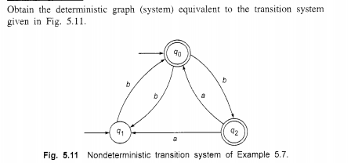

Slide 25
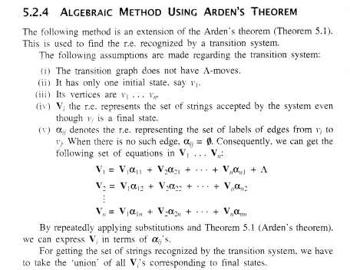

Slide 26
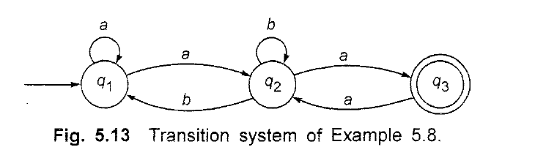
Construct RE from Finite Automata

Slide 27
answer
(a + a(b + aa)*b)*a(b + aa)*a

Slide 28
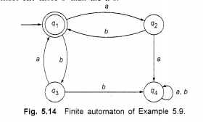
Construct RE from given DFA

Slide 29
Answer
(ab + ba)*

Slide 30
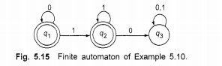
Construct RE from given DFA, take q1 as initial state

Slide 31
Answer
0*(1*)

Slide 32
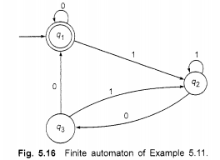
Construct RE from given DFA

Slide 33
Answer
(0 + 1(1 + 01)* 00)*

Slide 34
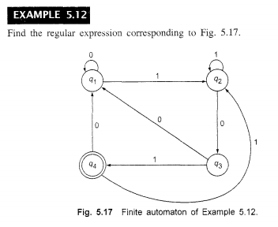
Construct RE from given DFA
Q1 as initial state

Slide 35
(0 + 1(1 + 011)*(00 + 010)*(1(1 + 011)* 01)

Slide 36
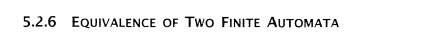
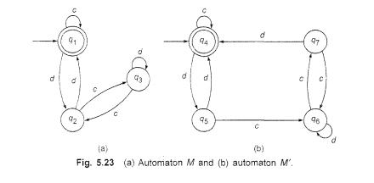

Slide 37
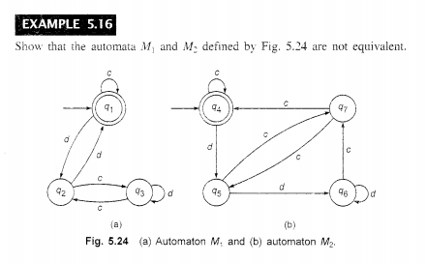

Slide 38
Closure properties of regular sets
Property 1. The union of two regular set is regular.
Proof −
Let us take two regular expressions
RE₁ = a(aa)* and RE₂ = (aa)*
So, L₁ = {a, aaa, aaaaa,.....} (Strings of odd length excluding Null)
and L₂ ={ ε, aa, aaaa, aaaaaa,.......} (Strings of even length including Null)
L₁ ∪ L₂ = { ε, a, aa, aaa, aaaa, aaaaa, aaaaaa,.......}
(Strings of all possible lengths including Null)
RE (L₁ ∪ L₂) = a* (which is a regular expression itself)
Hence, proved.

Slide 39
Closure properties of regular sets
Property 2. The intersection of two regular set is regular.
Proof −
Let us take two regular expressions
RE₁ = a(a*) and RE₂ = (aa)*
So, L₁ = { a,aa, aaa, aaaa, ....} (Strings of all possible lengths excluding Null)
L₂ = { ε, aa, aaaa, aaaaaa,.......} (Strings of even length including Null)
L₁ ∩ L₂ = { aa, aaaa, aaaaaa,.......} (Strings of even length excluding Null)
RE (L₁ ∩ L₂) = aa(aa)* which is a regular expression itself.
Hence, proved.

Slide 40
Closure properties of regular sets
Property 3. The complement of a regular set is regular.
Proof −
Let us take a regular expression −
RE = (aa)*
So, L = {ε, aa, aaaa, aaaaaa, .......} (Strings of even length including Null)
Complement of L is all the strings that is not in L.
So, L’ = {a, aaa, aaaaa, .....} (Strings of odd length excluding Null)
RE (L’) = a(aa)* which is a regular expression itself.
Hence, proved.

Slide 41
Closure properties of regular sets
Property 4. The difference of two regular set is regular.
Proof −
Let us take two regular expressions −
RE₁ = a (a*) and RE₂ = (aa)*
So, L₁ = {a, aa, aaa, aaaa, ....} (Strings of all possible lengths excluding Null)
L₂ = { ε, aa, aaaa, aaaaaa,.......} (Strings of even length including Null)
L₁ – L₂ = {a, aaa, aaaaa, aaaaaaa, ....}
(Strings of all odd lengths excluding Null)
RE (L₁ – L₂) = a (aa)* which is a regular expression.

Slide 42
Closure properties of regular sets
Property 5. The reversal of a regular set is regular.
Proof −
We have to prove L^{R} is also regular if L is a regular set.
Let, L = {01, 10, 11, 10}
RE (L) = 01 + 10 + 11 + 10
L^{R} = {10, 01, 11, 01}
RE (L^{R}) = 01 + 10 + 11 + 10 which is regular
Hence, proved.
Property 6. The closure of a regular set is regular.
Proof −
If L = {a, aaa, aaaaa, .......} (Strings of odd length excluding Null)
i.e., RE (L) = a (aa)*
L* = {a, aa, aaa, aaaa , aaaaa,……………} (Strings of all lengths excluding Null)
RE (L*) = a (a)*
Hence, proved.

Slide 43
Closure properties of regular sets
Property 7. The concatenation of two regular sets is regular.
Proof −
Let RE₁ = (0+1)*0 and RE₂ = 01(0+1)*
Here, L₁ = {0, 00, 10, 000, 010, ......} (Set of strings ending in 0)
and L₂ = {01, 010,011,.....} (Set of strings beginning with 01)
Then, L₁ L₂ = {001,0010,0011,0001,00010,00011,1001,10010,.............}
Set of strings containing 001 as a substring which can be represented by an RE − (0 + 1)*001(0 + 1)*

Slide 44
Construct DFA Equivalent to regular expression
(0 +1 )*(00 + 11)(0 + 1)*
10 + (0 + 11)0*1

Slide 45
Equivalence of 2 regular expression
Prove (a + b)* =a*(ba*)* by constructing regular expressions

Slide 46
CONSTRUCTION OF A REGULAR GRAMMAR
GENERATING T(M) FOR A GIVEN DFA M
Construct a regular grammar G generating the regular set represented by
P = a*b(a + b)*.

Slide 47
CONSTRUCTION OF A TRANSITION SYSTEM M
ACCEPTING L(G) FOR A GIVEN REGULAR
GRAMMAR G
Let G =({Ao, A1,, {a. b}. P, Ao). where P consists of Ao->aA1,A1->bA1,A1->a,A1->bA0
Construct a transition system M accepting L(G).

Slide 48
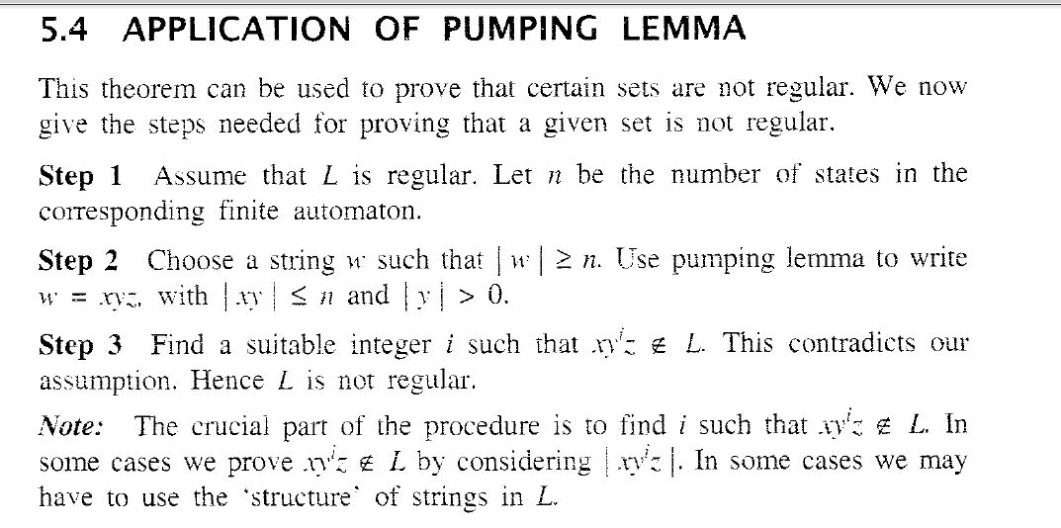
Pumping Lemma

